Slide 1
INF 2202 IS Strategy, Management and Acquisition Lecture #1
Information Systems in Global Business Today

Slide 2
Objectives
At the end of this lecture, you should be able to answer the following questions:
How are information systems transforming business and what is their relationship to globalization?
Why are information systems so essential for running and managing a business today?
What exactly is an information system? How does it work? What are its management, organization, and technology components?

Slide 3
Objectives
What are complementary assets? Why are complementary assets essential for ensuring that information systems provide genuine value for an organization?
What academic disciplines are used to study information systems? How
does each contribute to an understanding of information systems?
What is a sociotechnical systems perspective

Slide 4
The Role of Information Systems in Business Today
Information meaningful data (facts)
Societies mainly depend on the information
Information support to achieve desired objectives
Planning, organizing, decision making, …
IS process (handle) the data to be useful information
Through H/W, S/W, telecommunication, DB
IS computer systems related to process data and provide required information
ATMs, airline reservation systems, course reservation systems
Data
Processing
Information

Slide 5
Business process
Business process : tasks, rules, behaviors that been developed to produce business results.
eg.
Developing new product
Creating market plan
Hiring an employee
Considered source of competitive strength
IS automate many business process

Slide 6
Definitions
Data
System
Information
Information System
Business
Business Process

Slide 7
Role of IS in business today
IS transform (improve) business today. How?
1. Creating globalization opportunities: Internet reduced costs of operating, on global scale for Customers and firms, Using foreign markets, easily replicate service such as Google and ebay
2. Helps the emerging digital firm: The business relationships in digital firm are digitally enabled and mediated and It’s core business processes are accomplished through digital networks.
(Time shifting, space shifting)

Slide 8
Firms invest heavily in IS to achieve 6 strategic business objectives (why firms use IS?).
Strategic business objectives
1. Operational excellence
2. New products, services,
and business models
3. Customer and supplier intimacy
4. Improved decision making
5. Competitive advantage
6. Survival

Slide 9
1. Operational excellence:
IS Improvement of efficiency of operation to attain higher profitability
IT tool to achieve greater efficiency and productivity
Examble: Wal-Mart’s RetailLink system links suppliers to stores for superior replenishment system

Slide 10
2. New products, services, and business models
Business model: describes how company produces, delivers, and sells product or service to create wealth
Information systems and technology a major enabling tool for new products, services, business models
E.g. Apple’s iPod, iTunes and Netflix’s Internet-based DVD rentals

Slide 11
3. Customer and supplier intimacy
Serving customers well leads to customers returning, which raises revenues and profits
E.g. High-end hotels that use computers to track customer preferences and use to monitor and customize environment
Intimacy with suppliers allows them to provide vital inputs, which lowers costs
E.g. J.C.Penney’s information system which links sales records to contract manufacturer

Slide 12
4. Improved decision-making
Without accurate information:
Managers must use forecasts, best guesses, luck
Leads to:
Overproduction, underproduction of goods and services
Misallocation of resources
Poor response times
Poor outcomes raise costs, lose customers
IS provide real-time data for making decisions
E.g. Verizon’s Web-based digital dashboard to provide managers with real-time data on customer complaints, network performance, line outages, etc.

Slide 13

5. Competitive advantage
Achieve higher sales and profit through using IS by:
Doing things better
Charging less for superior products
real time Responding
Using the internet is competitive advantage
E.g. Dell: Consistent profitability over 25 years; Dell remains one of the most efficient producer of PCs in world.
But Dell has lost some of its advantages to fast followers-- HP

Slide 14

6. Survival
Information technologies are necessity of doing business
May be:
Industry-level changes, e.g. Citibank’s introduction of ATMs
Governmental regulations requiring record-keeping
E.g. Toxic Substances Control Act, Sarbannes-Oxley Act
Firms turn to IS and technologies to provide the capability to respond to these challenges.
Notes:
many federal and state statutes and regulations that create a legal
duty for companies and their employees to retain records, including digital
records. For instance, the Toxic Substances Control Act (1976), which regulates
the exposure of U.S. workers to more than 75,000 toxic chemicals, requires
firms to retain records on employee exposure for 30 years. The Sarbanes—
Oxley Act (2002), which was intended to improve the accountability of public
firms and their auditors, requires certified public accounting firms that audit
public companies to retain audit working papers and records, including all
e-mails, for five years. Many other pieces of federal and state legislation in
health care, financial services, education, and privacy protection impose
significant information retention and reporting requirements on U.S.
businesses.

Slide 15
IS, data, information
Information System
Set of interrelated components
Collect, process, store, and distribute information
→By computers and software as a tool
Support decision making, coordination, control, problem analysis and create new product
Provide solutions to challenges in business Environment.
Information vs. data
Data are streams of raw facts
Information is data shaped into meaningful form

Slide 16
IS: input, process, output, feedback
IS: activities produce required information
Input: Captures raw data from organization or external environment
Processing: Converts data into meaningful form
Output: Transfers processed information to people or activities that use it
Feedback: Output returned to appropriate members of organization to help evaluate or correct input stage

Slide 17
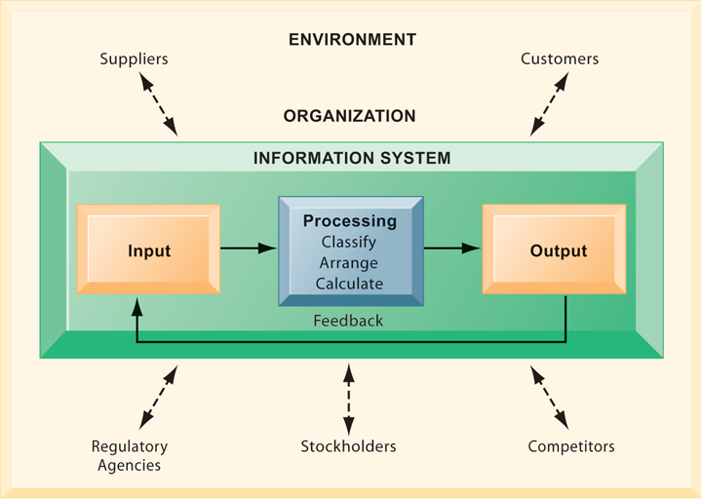
Perspectives on Information Systems
Functions of an Information System

Slide 18
Perspectives on Information Systems
An information system contains information about an organization and its surrounding environment.
Three basic activities—input, processing, and output—produce the information organizations need.
Feedback is output returned to appropriate people or activities in the organization to evaluate and refine the input.
Environmental actors, such as customers, suppliers, competitors, stockholders, and regulatory agencies, interact with the organization and its information systems.

Slide 19

Computer/Computer program vs. information system
A house is an appropriate analogy.
Houses are built with hammers, nails, and wood, but these do not make a house.
The architecture, design, setting, landscaping, and all of the decisions that lead to the creation of these features are part of the house and are crucial for solving the problem of putting a roof over one’s head.

Slide 20
Computer/Computer program vs. information system
Computers and programs are the hammers, nails, and lumber of computer-based information systems, but alone they cannot produce the information a particular organization needs.
To understand information systems, you must understand the problems they are designed to solve, their architectural and design elements, and the organizational processes that lead to
these solutions.

Slide 21
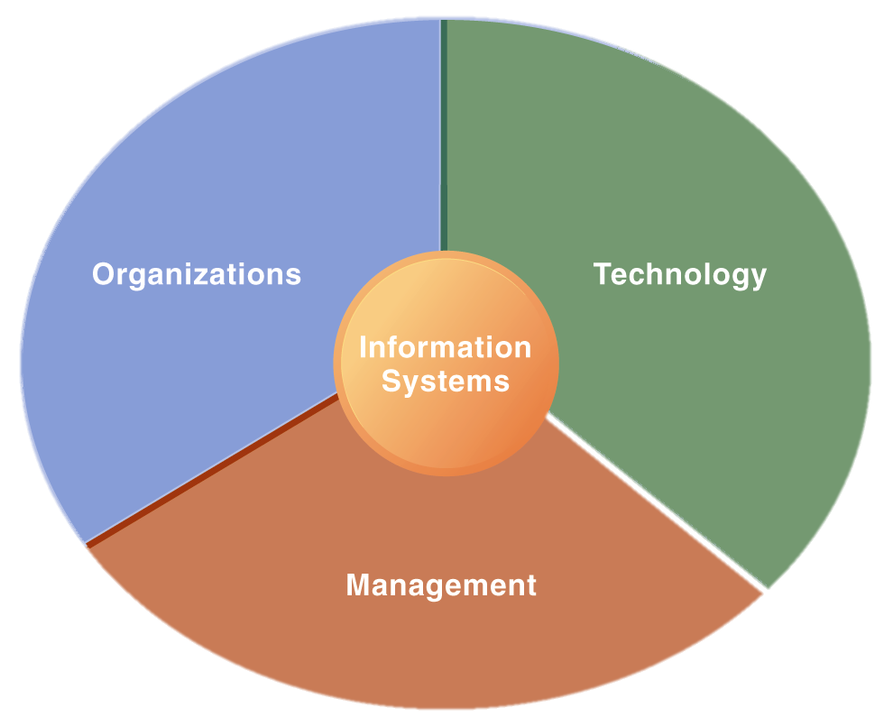
Dimensions (boarders) of IS
To fully understand information systems, you must understand
the broader organization
Management
information technology dimensions of systems
their power to provide solutions to challenges and problems in the business environment.
We refer to this as Information Systems Literacy.

Slide 22
Dimensions (boarders) of IS
Computer literacy, in contrast, focuses primarily on knowledge of information technology.
Therefore:
Understanding of IS dimensions is IS literacy
Where computer literacy is focus on primarily on knowledge of IT
The field of MIS try to achieve this boarders of IS literacy, deals with behavioral and technical issues surrounding development, use and impact of IS used by managers and employees in the firm.

Slide 23
1. Organizational dimension of IS
The key elements of an organization are:
Its people
Structure
business processes
Politics
culture.

Slide 24
Organizational dimension of IS
Structure
Organizations have a structure that is composed of different levels and specialties.
Their structures reveal a clear-cut division of labour. Authority and responsibility in a business firm are organized as a hierarchy, or a pyramid structure.
The upper levels of the hierarchy consist of managerial, professional, and technical employees, whereas the lower levels consist of operational personnel.

Slide 25
Levels in the firm
Senior Management
Middle Management Scientists and Knowledge workers
Operational Management
Knowledge workers
Data workers
Products or service workers
Senior management makes long-range strategic decisions about products and services as well as ensures financial performance of the firm.
Middle management carries out the programs and plans of senior management
Operational management is responsible for monitoring the daily activities of the business
Knowledge workers, such as engineers, scientists, or architects, design products or services and create new knowledge for the firm
Data workers, such as secretaries or clerks, assist with scheduling and communications at all levels of the firm.
Production or service workers actually produce the product and deliver the service

Slide 26
Business Functions
The major business functions, or specialized tasks performed by business organizations consists the following:
Sale and Marketing
Manufacturing and Production
Finance and Accounting
Human resources
Selling the Organization’s product and services
Producing delivering products and services
Managing the Organization’s financial assets and maintaining the organization’s financial records
Attracting, developing and maintaining the organization’s labor force and employee records

Slide 27
2. Management dimension
Management’s job is to make sense out of the many situations faced by organizations
Make decisions, formulate action plan and solve organizational problems
Managers set organizational strategies for responding to business challenges perceived from the environment
In addition, managers must act creatively:
Creation of new products and services
Occasionally re-creating the organization from time to time

Slide 28
3. Technology dimension
Information technology is one of many tools managers use to cope with change.
Information Technology is:
Hardware: physical component
Software: instruction control Hardware
Data management technology
Network and telecommunications technology
Network: Hardware + Software link computers
Internet: Network to provide services
WWW: service to store retrieve information

Slide 29
Business perspective on IS:
IS instrument for creating value to firms
Investments in IS result in superior returns:
Increases productivity and revenue
IS provides information that helps managers making better decisions and improve the execution of business process
Value of IS

Slide 30
There variation in Returns on Information Technology Investment
Investing in information technology does not guarantee good returns
Considerable variation in the returns firms receive from systems investments
Factors that case The variation in Returns :
Adopting right business model according (suite) to new technology
coordinating investments (business processes, models, management behavior and culture)

Slide 31
Complementary assets:
Awareness of the organizational and managerial dimensions of IS can help us understand why some firms achieve better results from their information systems than others
Some firms invest a great deal and receive a great deal, others invest an equal amount and receive few returns
Still other firms invest little and receive much
This suggests that investing in information technology does not by itself guarantee good returns

Slide 32
What accounts for this variation among firms
The answer lies in the concept of Complementary assets.
Information technology investments alone cannot make organizations and managers more effective unless they are accompanied by supportive values, structures, and behaviour patterns in the organization and other complementary assets.
Business firms need to change how they do business before they can really reap the advantages of new information technologies.
Some firms fail to adopt the right business model that suits the new technology, or seek to preserve an old business model that is doomed by new technology

Slide 33
What is Complementary Assets
Complementary assets are those assets required to derive value from a primary investment (Teece, 1988).
For instance, to realize value from automobiles requires substantial complementary investments in highways, roads, gasoline stations, repair facilities, and a legal regulatory structure to set standards and control drivers

Slide 34
Complementary Assets
Firms that support their technology investments with investments in complementary assets, such as new business models, new business processes, management behaviour, organizational culture, or training, receive superior returns
Whereas those firms failing to make these complementary investments receive less or no returns on their information technology investments
These investments in organization and management are also known as organizational and management capital.

Slide 35
Complementary Assets
The major complementary investments that firms need to make to realize value from their information technology investments
Organizational assets
Supportive organizational culture that values efficiency and effectiveness
Managerial assets
Strong senior management support for technology investment and change
Social assets
The Internet and telecommunications infrastructure
Appropriate business model
Efficient business processes
Decentralized authority
Distributed decision-making rights
Strong IS development team
Incentives for management innovation
Teamwork and collaborative work environments
Training programs to enhance management decision skills
Management culture that values flexibility and knowledge-based decision
making.
IT-enriched educational programs raising labor force computer literacy
Standards (both government and private sector)
Laws and regulations creating fair, stable market environments
Technology and service firms in adjacent markets to assist implementation

Slide 36
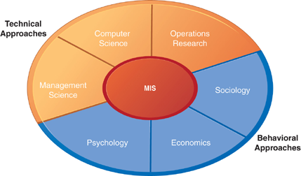
Contemporary approach to IS
The study of information systems is a multidisciplinary field.
No single theory or perspective dominates.
Figure below illustrates the major disciplines that contribute problems, issues, and solutions in the study of information systems

Slide 37
Technical approach:
Emphasizes mathematically based models
Computer science theories of commutation ,data storage
management science: models of DM and practices
operations research: optimizing selected parameters of organization.

Slide 38
Behavioral approach
: Behavioral issues such strategic business integration, implementation...
Psychology: how decision makers use formal information
Economics: how IS change the control and cost structures
Sociology: how system affect individuals and groups

Slide 39


